Slide 1

Chapter 2: Basics of Computer Architecture
Smruti R Sarangi
IIT Delhi

Slide 2
Outline of this Chapter
Cores, registers and interrupts
x86 assembly
Virtual memory
I/O

Slide 3

Design of a Modern Multicore Chip
4-64 cores
Hierarchy of caches
1st level: i-cache and d-cache
2nd level: L2 cache (MBs)
3rd level: L3 cache (MBs)
Off-chip main memory
Caches
Main memory

Slide 4
Cores and Registers
Registers
Core
Every core has a set of registers – named storage locations
They number from 8-32. They can be accessed very quickly (fraction of a clock cycle).
Most of the CPU’s operations are performed usually on registers.
RISC machines first load memory values into registers and then perform operations on them
CISC machines can have one source operand from memory (lower register usage)

Slide 5
What does the register set of a typical machine look like?
General purpose registers: These registers can be used by all programs
The rest are all privileged registers. They can only be used in certain processor modes (e.g., by the OS, hypervisor, etc.)
Hidden registers: Example → flags register. This stores the result of the last comparison.
Control registers: Use them to enable/disable certain processor features
Debug registers: Debug hardware and system software
I/O registers: read/write I/O devices, access their status information

Slide 6
Current Privilege Level
Current Privilege Level
Current Privilege Level (CPL) bit (s)
In general CPL=0 indicates privileged OS mode and CPL=1 indicates user mode
Extended to Rings
Ring 3
Ring 0
Lower the ring →
Higher the privilege

Slide 7
Privileged and Non-Privileged Instructions
There are two kinds of instructions – privileged and non-privileged
Non-privileged instructions
Regular instructions
When they access privileged registers, several things can happen
An exception may be generated
There will be some effect
There will be no effect at all (fully silent)
Privileged instructions
Can access all registers
Exceptions are not generated
Dangerous !!! (we will discuss when introducing VMs)

Slide 8
Interrupts, Exceptions, and System Calls
Interrupts
An interrupt is an externally generated event whose main job is to draw the attention of the CPU. They are mainly generated by I/O devices and other chips in the chipset.
An exceptional condition in a program such as accessing an illegal memory address or dividing by zero. There is a need to suspend the program and take some action to rectify the situation.
Exceptions
There are specialized instructions in ISAs to generate a “dummy exception”. They lead to a suspension of the program’s execution and invocation of an OS routine. This mechanism can be used to pass data to the OS such that it can perform a service for the user program. Such a convoluted OS function call mechanism is known as a system call.
System calls

Slide 9
System calls in x86-64 Linux
See arch/x86/entry/syscalls/syscall 64.tbl (548 systems calls)
mov $<sys call number>, %rax
syscall
Move the system call number to the rax register
Issue the “syscall” instruction
Another option: int $0x80 (software interrupt)

Slide 10


All are handled in the same manner
The idea is to knock on the doors of the
operating system to draw its attention.
Either rely on a hardware interrupt that the CPU uses as a pretext to invoke an OS routine
OR, treat a fault/exception in the program as an interrupt
OR, generate a software interrupt yourself to ask the OS to do some work for you
Kind of a weird way of drawing the OS’s attention. The only way to talk to the fireman is by setting your house on fire.

Slide 11
Now what does the CPU do?
Something has happened, the OS needs to take a look
Save the state of the executing process
Load the interrupt handler
Then figure out what needs to be done

Slide 12

Saving the State: Context Switch
Registers
Flags and special registers
Program state
Memory
PC
No need to save and restore
Register state
Store the register state somewhere
The memory of the process should remain untouched
Store the PC of the last executed instruction, or next PC (point of resumption)
Then do other work
Later on, restart the process from the point of resumption
It never gets to know

Slide 13

Lifecycle of a Process
Context
switch
Context
switch
OS + other processes execute
OS + other processes execute
Execution
Execution
Execution
The process has no way of knowing that it is being swapped out and being swapped in
It is agnostic to context switches

Slide 14
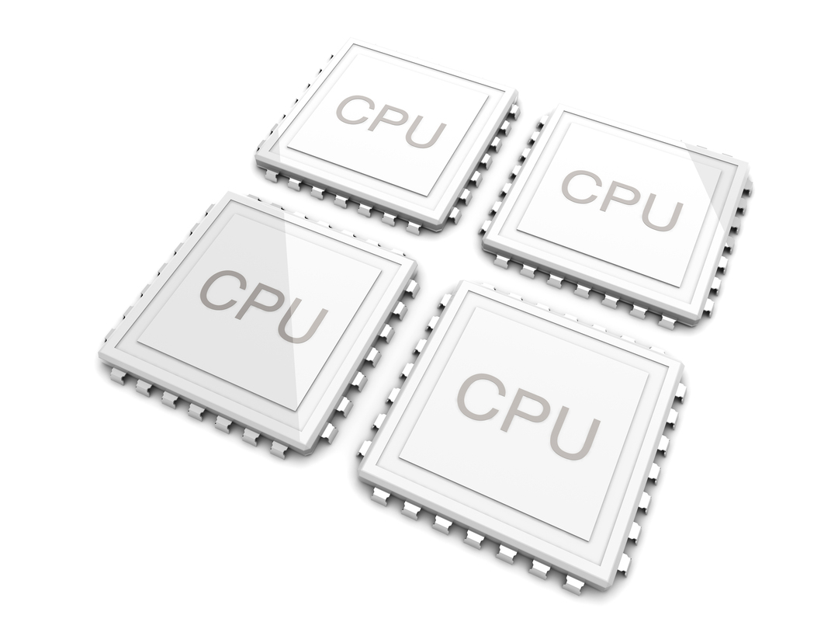


How does the OS see a process?
The OS treats the process as a suitcase containing some state. It can be seamlessly moved from core to core on a multi-core CPU. It can be suspended at will and brought back to life at a future point of time without the process knowing.

Slide 15





A Question to Ponder About?
What if there are no interrupts, exceptions, and system calls?
In principle, an application can continue to run forever.
It will never get swapped out and will continue to monopolize the processor.
Have an external time chip on the motherboard. Generates a dummy interrupt (timer interrupt) once every jiffy
A jiffy = 1 ms (as of today)
Guaranteed source of interrupts

Slide 16
Why do you need a guaranteed source of interrupts?
This is to allow the OS to periodically execute and make process scheduling decisions.
Otherwise, the OS may never get a chance to execute. For it to execute, it needs to be invoked by any one of the three mechanisms: interrupts, exceptions or system calls.
The latter two are not relevant here. We need to thus generate timer interrupts.

Slide 17

Relevant Kernel Code
include/linux/jiffies.h
extern unsigned long volatile jiffies;
The jiffy count is incremented once every time there is a timer interrupt. The interval is determined by the compile-time parameter HZ. If HZ = 1000, then it means that the timer interrupt interval = 1 ms

Slide 18
Outline of this Chapter
Cores, registers and interrupts
x86 assembly
Virtual memory
I/O

Slide 19

Introduction to Assembly Languages
A large part of the kernel code is written in assembly language
We need low-level control of the hardware.
Speed and efficiency
Limited code size
Specify the exact code that will be executed
32 bit
x86 ISA
64 bit

Slide 20
View of Registers
Modern Intel machines are still ISA compatible with the arcane 16-bit 8086 processor
In fact, due to market requirements, a 64-bit processor needs to be ISA compatible with all 32-bit, and 16-bit ISAs (same family)
What do we do with registers?
Do we define a new set of registers for each type of x86 ISA? ANSWER : NO

Slide 21
View of Registers – II
Consider the 16-bit x86 ISA – It has 8 registers: ax, bx, cx, dx, sp, bp, si, di
Should we keep the old registers, or create a new set of registers in a 32-bit processor?
NO – Widen the 16-bit registers to 32 bits.
If the processor is running a 16-bit program, then it uses the lower 16 bits of every 32-bit register.

Slide 22
View of Registers – III
64 bits
32 bits
16 bits
rax
eax
ax
rbx
ebx
bx
rcx
ecx
cx
8 registers
64, 32, 16
bit variants
rdx
edx
dx
rsp
esp
sp
rbp
ebp
bp
rsi
esi
si
rdi
edi
di
r8
The 64-bit ISA has
8 extra registers
r8 - r15
r9
r15

Slide 23
x86 can even Support 8-bit Registers
ax
ah
al
bx
bh
bl
cx
ch
cl
dx
dh
dl
For the first four 16-bit registers
The lower 8 bits are represented by al, bl, cl, dl
The upper 8 bits are represented by ah, bh, ch, dh

Slide 24
x86 Flags Registers and PC
Fields in the flags register
64 bits
32 bits
Field
Condition
Semantics
16 bits
OF
Overflow
Set on an overflow
rflags
eflags
flags
CF
Carry flag
Set on a carry or borrow
ZF
Zero flag
Set when the result is 0, or the
rip
eip
ip
comparison leads to an equality
SF
Sign flag
Sign bit of the result
Similar to the classical flags registers in RISC ISAs
It has 16-bit, 32-bit, and 64-bit variants
The PC is known as the IP (instruction pointer)

Slide 25
Intel and AT&T Formats
The same code can be written in two different formats: Intel and AT&T
The Linux kernel and the toolchain uses the AT&T format (which is older and often not preferred by modern developers)
Intel
AT&T
add eax, ebx
eax = eax + ebx
addl %ebx, %eax
destination comes at the end
mov [esp+4], eax
Set the memory
location with address
esp+4 to the contents of eax
Set the memory
location with address
esp+4 to the contents of eax
movl %eax, 4(%esp)

Slide 26
Floating-point Registers
FP register
stack
st0
st1
st0
st2
st0
st3
st4
st5
st6
st7
x86 has 8 (80-bit) floating-point registers
st0 – st7
They are also arranged as a stack
st0 is the top of the stack
We can perform both register operations, as well as stack operations

Slide 27
Memory Addressing Mode
Support for direct addressing
$$address=disp(base, index, scale)$$
address = base + index*scale + disp
x86 supports a base, a scaled index and an offset (known as the displacement)
Each of the fields is optional
Examples
-32(%eax, %ebx, 0x4)
(%eax, %ebx)
4(%esp)

Slide 28
Assembly code for computing a factorial
movl $1, %edx
movl $1, %eax
.L2:
imull %eax, %edx
addl $1, %eax
cmpl $11, %eax
jne .L2
edx = edx * eax
eax++
Exit condition

Slide 29
Brief Detour: Compiling and Linking
Any large project comprises 100s of C/C++ files.
How do we create a single executable out of them?
Machine-code versions of the code in the .c file. Cannot run.
The compiler can only look at one C file at a time
gcc –c x.c
x.c
x.o
y.c
y.o
a.out
The final executable that runs.
z.c
z.o
Linking
Command: ld

Slide 30
What does a .o file contain?
Sections (objdump -x <file.o>)
.text (the machine instructions for the C code)
.data (initialized data)
.bss (uninitialized data)
.rodata (read-only data)
.comment
The symbol table (objdump --syms <file.o>)
The list of all the symbols that are used (both defined and undefined)
The relocation table (objdump --reloc <file.o>)
The symbols that need to be resolved at link time

Slide 31

How are developers supposed to collaborate?
Defines the factorial function
Uses the factorial function defined in factorial.c
factorial.c
prog.c
How will this happen?
Compilers take a look at each C file individually
When the compiler is trying to convert prog.c to prog.o, it needs some information about the factorial function.
What is the signature of the factorial function?
Answer:
int factorial (int). Arguments and type of the return value

Slide 32

A few follow-up questions
Where does prog.c get the signature of the factorial function from?
Bad way
Define it in prog.c before the function is used.
extern int factorial (int)
We cannot change the signature later. This will clutter the C code. If many C files are using this function, then there is a lot of code replication.
Good way
Define the signature in a header file: factorial.h
Just include factorial.h to get the signature: #include <factorial.h>
The pre-processor simply copy-pastes the contents of the header file to the relevant place in the C file.
Great idea for quickly exporting signatures to any C file that is interesting in using functions defined in another C file.

Slide 33
New Structure
factorial.h
Declaration of the factorial function
#include
Symbol table
Defines the factorial function
Uses the factorial function defined in factorial.c
factorial.c
prog.c
What is the address of the factorial function in prog.o?
It is unresolved.
There is an entry in the relocation table (in the .o file) that says that the symbol “factorial” is undefined.
At link time, the symbol is substituted with its real address
The call instruction that calls factorial finally points to the correct address – address of the first byte of the factorial function in memory

Slide 34
Static Linking
Along with functions defined in other C files, a typical executable calls a lot of functions that are defined in the standard C libraries (essentially large .o files). Examples: printf, scanf, time, etc.
Do we bundle all of them together?
test.c
#include <stdio.h>
int main(){
int a = 4;
printf ("%d",a);
}
Add the code to a.out
Let us try
gcc –static test.c
ldd a.out not a dynamic executable
du –h a.out 892K a.out
Check if all the functions are bundled or not
The size of the binary is quite large because the code of the entire library is included in a.out

Slide 35

Why is a.out so large?
This is because the code of all possible functions that can be invoked by a.out is added to it
Imagine a program can possibly invoke 100 functions. However, in a realistic run, only 3 functions are invoked.
There is no need to add the code of all the 100 functions to a.out.
Add the code of functions to the process’s address space on an on-demand basis
gcc test.c
ldd a.out linux-vdso.so.1 => (0x00007ffc51fd3000)
libc.so.6 => /lib/x86_64-linux-gnu/libc.so.6 (0x00007f984d6a7000)
/lib64/ld-linux-x86-64.so.2 (0x00007f984da71000)
du –h a.out 12K a.out
Dynamic Linking
a.out just has pointers to functions
Ultra-small

Slide 36
All about Dynamic Linking
first time
Locate the function in a library
printf
Stub function
subsequently
Call the function using its address
Copy the function to the address space of the process
This means that we load functions “on demand” and the size of the binary remains small
When we study virtual memory, we shall realize that copying the full code of the function is not necessary. A simple mapping can achieve the same. This means that only a single copy of printf needs to be resident in memory.
Store the address of the function

Slide 37
Example of Creating and Using a Static Library
Three files
factorial.c
#include "factorial.h"
int factorial (int val){
int i, prod = 1;
for (i=1; i<= val; i++) prod *= i;
return prod;
}
prog.c
#include <stdio.h>
#include "factorial.h"
int main(){
printf("%d\n",factorial(3));
}
factorial.h
#ifndef FACTORIAL_H
#define FACTORIAL_H
extern int factorial(int);
#endif

Slide 38

Default
In a large project we maintain a list of compiled .o files and compile as few files as possible when there is a new change. A Makefile and the make command automate this process. All that the programmer needs to type is make. The rules are in the Makefile.
gcc factorial.c prog.c
./a.out 6
Plain, old, simple, and inefficient
gcc –c factorial.c –o factorial.o
gcc –c prog.c –o prog.o
gcc factorial.o prog.o
./a.out 6
Compile .o files separately

Slide 39
Static and Dynamic Linking
gcc –c factorial.c –o factorial.o
ar –crs factorial.a factorial.o
gcc prog.o factorial.a
./a.out 6
The ar command creates a library out of several .o files
factorial.a is a library that is statically linked in this case
gcc –c –fpic –o factorial.o factorial.c
gcc –shared –o libfactorial.so factorial.o
gcc –L. prog.c -lfactorial
export LD_LIBRARY_PATH=`pwd`
./a.out 6
Generate position independent code
Create the shared library
Create the executable. Reference the shared library.
Tell the system that the factorial library is in the current directory

Slide 40
Some Important Linux Commands
ldd → Display the location of the shared libraries on your file system
objdump → See all the contents of an object (.o) file Table, sections, machine instructions (also in the disassembled form)
readelf → More expressive than objdump
nm <file.o> → List the symbols in object files
strip <file.o> → Discard symbols from object files
ranlib <archive> → Generate an index for an archive

Slide 41
Outline of this Chapter
Cores, registers and interrupts
x86 assembly
Virtual memory
I/O

Slide 42

Compatibility, Overlap and Size Problems
How does a process view memory?
Answer:
One large array of bytes. Any location can be accessed.
In a 64-bit addressing system, the user assumes that all the locations from 0 to 2⁶⁴ – 1 can be accessed. The physical memory may be 1 GB (30 bits).
Compatibility problem

Slide 43


Overlap and Size Problems
Can one process access the data written by another process?
Overlap Problem
Overlapping addresses
If a program requires 2 GB of memory but the system has only 1 GB of memory, do we always need to terminate the program?
Can’t we use the hard disk to temporarily expand the available memory?
Size Problem

Slide 44
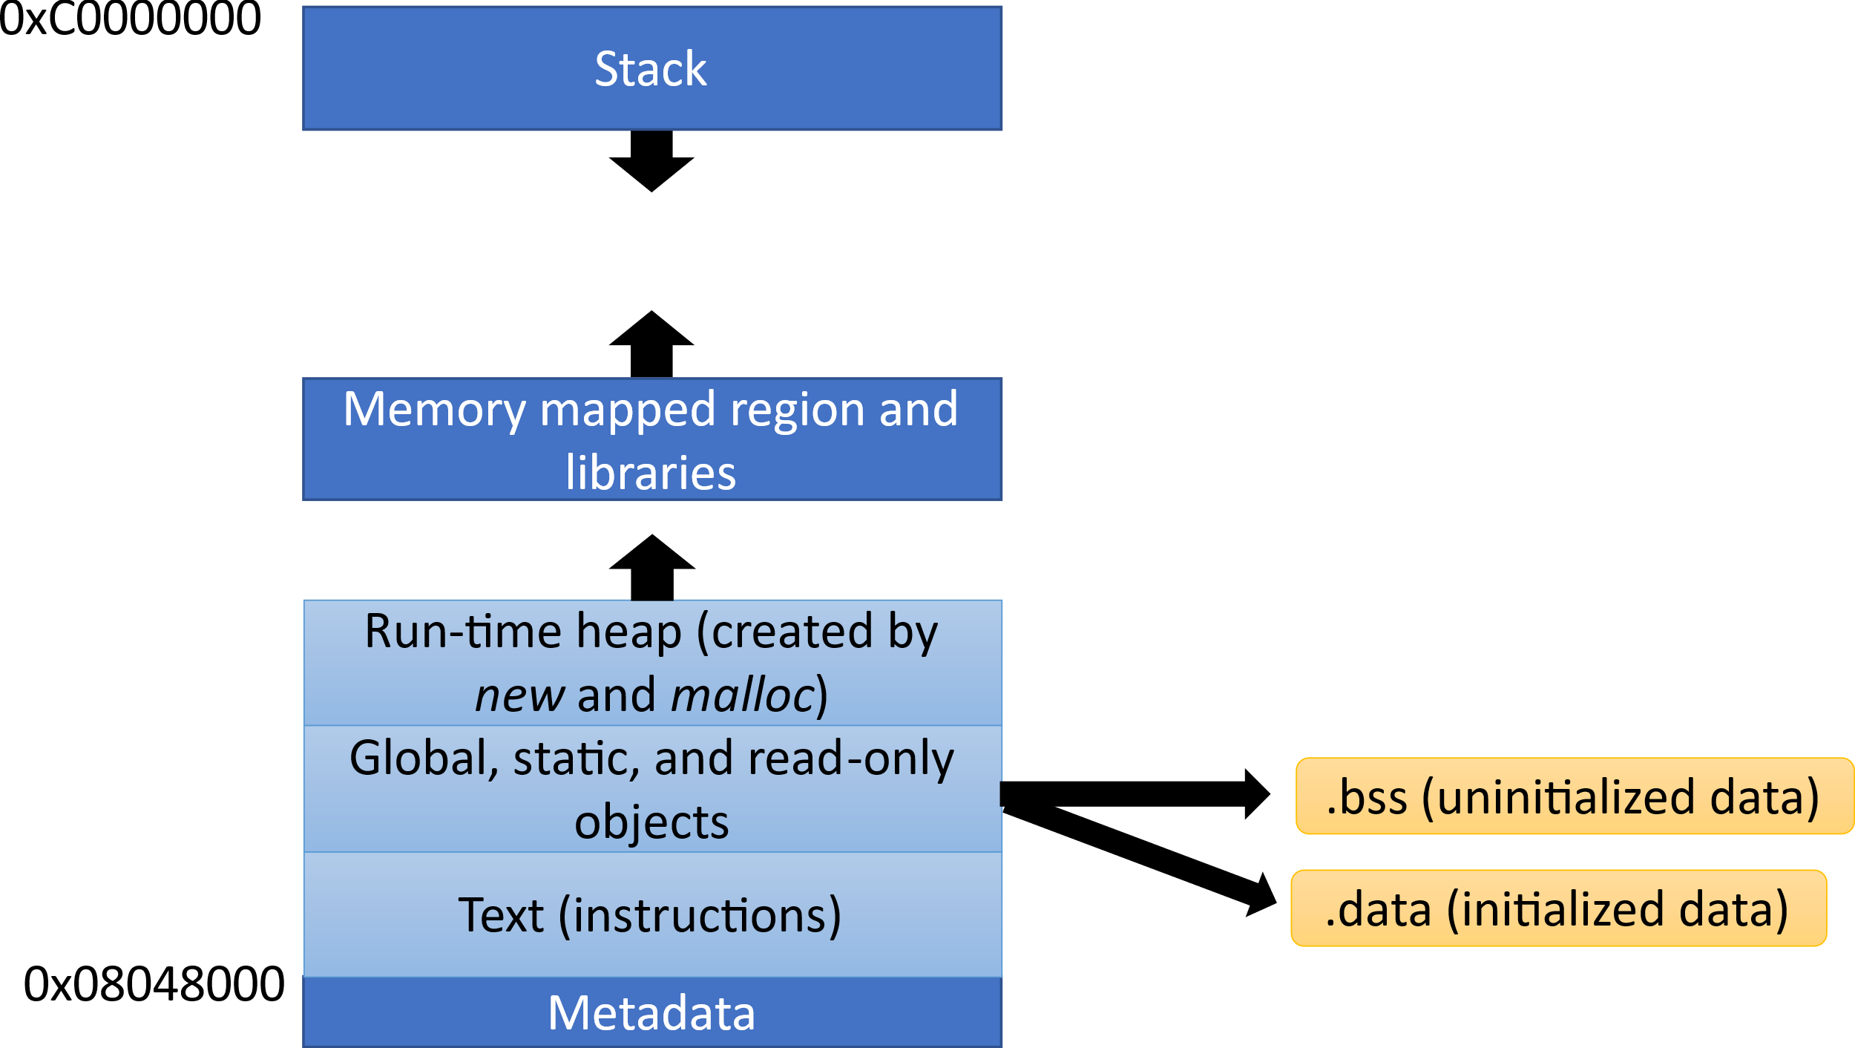
Memory Map of a Process
32-bit memory system
Different processes access similar addresses

Slide 45
Solve the Compatibility and Overlap Problems
Virtual address
Mapping Table
Physical address
Seen by the compiler, process and CPU
Seen by the memory system

Slide 46
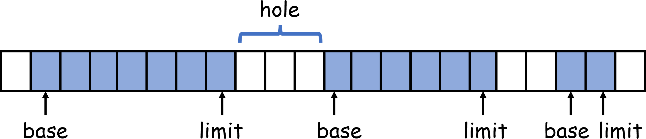
Base and Limit Scheme
Each process is assigned a contiguous memory region between base and limit
A new process needs to be allotted memory in the holes (between regions)
There are a lot of problems with this scheme

Slide 47

Problems with the Base and Limit Scheme
It is hard to guess the maximum amount of memory a process may use.
We need to use conservative estimates. Some memory will inevitably be wasted → internal fragmentation
A lot of memory will be wasted in holes. Even when adequate memory is available, it may be hard to allocate memory for a process because a large enough hole may not be found.
External fragmentation

Slide 48
Solution: Virtualize the Memory
Divide memory into 4-KB chunks
Process 1
Map process’s virtual pages to physical frames
Process 2

Slide 49


How is the Mapping Table Designed?
Page Table
64-bit virtual address
64-bit physical address
What do we know?
52 bits
12 bits
We know that a page or a frame has a size of 4 KB (2¹² bytes)
The virtual page or physical frame address is thus 52 bits
We cannot possibly create a structure that has 2⁵² entries

Slide 50


Leverage a Pattern (Use a Memory Map)
2⁴⁸ - 1
Stack
Large empty
spaces !!!
Memory mapped region and libraries
Use the pmap command
to find the memory map of a process
Run-time heap (created by new and malloc)
Global, static, and read-only objects
.data (initialized data)
Text (instructions)
.bss (uninitialized data)
0x400000
0
Metadata

Slide 51

Design a Data Structure that Leverages the Structure of the Memory Map
LSB bits have more randomness,
MSB bits have less randomness
The MSB bits determine the memory region
Multi-level Page Table
Consider the first (36 + 12) bits in the 64-bit x86 memory address. Assume
that bits 49-64 are all zeros in the virtual address [standard assumption].
48-bit Virtual address
Bits 48-40
Bits 39-31
Bits 30-22
Bits 21-13
12 bits (intra-page)
Level 3
Level 4
52-bit frame address
Level 1
Level 2
CR3 register

Slide 52

Use of the TLB
A page table access is very slow.
Speed it up using a HW cache called the TLB that stores the most frequent mappings
The TLB (Translation Lookaside Buffer) tries to translate the address. It is a fast HW structure (32 to 128 entries)
If it does not have the mapping, it requests the SW-resident page table for a translation
The physical address is sent to the caches
CPU generates the virtual address

Slide 53
What about the “size” problem?
Assume that a process wishes to access 3 GB of memory, but we only have 2 GB of main memory.
Answer:
Store 2GB in main memory and store the remaining 1GB on the hard disk or any other storage device. Let us refer to the “non-main memory” region as the swap space.
Use the virtual memory mechanism to manage the memory map.
Frame in main memory
Page table entry
Frame stored in the swap space

Slide 54


Swap Space
The swap space is a generic concept
Page fault
If there is a TLB miss and the page table indicates that the frame is in the swap space, then bring it into the main memory first.
The swap space could be on the local hard disk or could be on the hard disk of a remote machine. There could be several swap spaces as well.
54

Slide 55



Memory Management
Before accessing data, it needs to be present in the main memory, regardless of wherever it is stored.
The main memory has finite size.
If it is full, then we need to evict a frame to make space.
Which one
There are different heuristics: least recently used, least frequently used in a given timeframe, most frequently used, FIFO, random, etc.
An optimal solution exists: Evict the frame that will be used farthest in the future

Slide 56

Page Protection and Information Bits
Each entry of the page table or TLB has additional page protection bits.
Bit | Function
Present | Present in the main memory or not
RW | Set if the page can be written to
User | If the page can be accessed from user space
Dirty | Has a page been written to
These bits can be used to make a page read-only. This is a vital security measure for pages that contain code.

Slide 57


Questions on Efficiency
Where does a page table save memory?
Answer:
Very few entries in the Level 1 page table are full. This means that there are a few Level 2 page tables. There are slightly more Level 3 page tables and much more Level 4 page tables. The sparse structure of the memory map minimizes the number of page tables.
Do we access the page tables on a memory access?
Answer:
Too slow
What do we do then?
Answer:
Use a HW structure to cache frequent mappings. It is the TLB (Translation
Lookaside Buffer). We cache 32-128 entries. We can access in 1 cycle.

Slide 58

Segmentation

Slide 59
Segmented View of Memory in x86
x86 follows a segmented memory model
Each virtual address in x86 is generated by adding the computed address to the contents of a segment register.
For example, an instruction address is computed by adding an offset to the contents of the code segment register
Logical address
CS Register
Linear address
Virtual memory

Slide 60
Segmentation in x86
16-bit segment registers
These registers are private to a CPU
cs
es
ss
fs
ds
gs
x86 has 6 different segment registers
Each register is 16 bits wide
Code segment (cs), data segment (ds), stack segment (ss), extra segment (es), extra segment 1 (fs), extra segment 2 (gs)
Depending upon the type of access, the CPU uses the appropriate segment register

Slide 61
Segmented vs Linear Memory Model
In a linear memory model (e.g. RISC-V, ARM) the address specified in the instruction is sent to the memory system
There are no segment registers
What are the advantages of a segmented memory model?
The contents of the segment registers can be changed by the operating system at runtime. Randomizes the address (good for security).
Can map the text section(code) to a dedicated part of memory, or in principle to other devices also (needed for security)
Stores cannot modify the instructions in the text section. REASON : Stores use the data segment, and instructions use the code segment
The segment registers can store pointers to special memory regions. No need to load their addresses over and over again.

Slide 62

How does Segmentation Work?
The segment registers nowadays contain an offset into a segment descriptor table
Because 16 bits are not sufficient to store a memory address
The segment descriptor contains additional information: metadata, base address, limit, type, execute permission, privilege level
Modern x86 processors have two kinds of segment descriptor tables
LDT (Local Descriptor Table), 1 per process, typically not used nowadays
GDT (Global Descriptor Table), can contain up to 8191 entries
Each entry in these tables contains a segment descriptor

Slide 63
Segment Descriptor Cache (similar to a TLB)
Every memory access needs to access the GDT: VERY SLOW
Use a segment descriptor cache (SDC) at each processor that stores a copy of the relevant entries in the GDT
Lookup the SDC first
If an entry is not there, send a request to the GDT
Quick, fast, and efficient
GDT
Logical address
Linear address
SDC
Virtual memory
Segment Register

Slide 64
Segmentation in x86-64
Nowadays with x86 (64 bits) only two segment registers are used: fs and gs
The GDT is also not used. It has been replaced by MSRs (model specific registers)
The Linux kernel uses the gs segment to store per-CPU data.
The gcc compiler also uses them to store thread-local data
Example
movl $32, %fs:(%eax)

Slide 65
Outline of this Chapter
Cores, registers and interrupts
x86 assembly
Virtual memory
I/O

Slide 66

The Motherboard and Chipset
The CPU is assisted by a set of chips that help it manage the memory, storage, and I/O devices. They comprise the chipset.

Slide 67

Diagram of the Motherboard
CPU
GPU
Northbridge
Memory
slots
PCI
slots
Southbridge
Keyboard, mouse, USB ports, I/O chips, ...

Slide 68

x86 I/O Instructions
Port-Mapped I/O (PMIO)
When the system boots, each I/O device is provided multiple 16-bit I/O addresses
The OS can query this information and figure out the I/O addresses associated with each device.
These are known as ports.
It is possible to write a value to a port or read a value from it.
x86 has dedicated in and out instructions to access I/O ports
Scalability is an issue. We cannot read and write a lot of data in one go.

Slide 69
Memory Mapped I/O
Virtual address space
Mapped to I/O addresses
I/O device ports
Use the virtual memory mechanism to map a portion of the virtual address space to I/O devices
Use regular reads and writes to access I/O devices
The system automatically routes memory traffic to the I/O devices (bulk transfers possible)

Slide 70


DMA (Direct Memory Access)
Assume that a large amount of data (several MBs) needs to be transferred from the hard disk to the main memory.
Why should the program involve itself in this process, if this can be outsourced to a separate chip – the DMA controller?
Just give it a pointer to the region in the storage device (hard disk in the case), and the main memory. It does the transfer on its own and interrupts the chip once done.
CPU
1. Transfer details (device ↔memory)
DMA
2. Interrupt the CPU (transfer done)

Slide 71



srsarangi@cse.iitd.ac.in

